Slide 1
SARDAR PATEL INSTITUTE OF TECHNOLOGY , PILUDARA
Branch :- Civil Engg.
Elements Of Mechanical Engineering
Group Name :-
Prajapati Laxman
Prajapati Vikas
Sanodariya Harsad
Thakor Bhavana
Rakholiya Bhavdip
Guided By-R.N.PaTEL

Slide 2
Gears

Slide 3
Gear drives
Gear drive is very important drive in mechanical power transmission. Gear drive is positive drive. Gear drives are preferred when
larger or moderate power is to be transmitted
at constant velocity ratio.

Slide 4
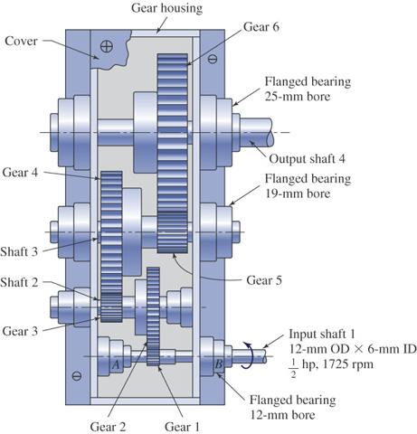
Gears

Slide 5
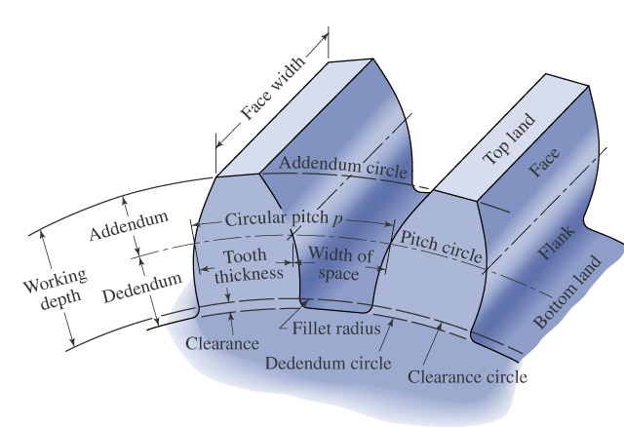

Slide 6
Advantages of gear drives
It is positive drives.
It is very convenient for very small center distance.
In gear drives, the velocity ratio will remain constant throughout.
It can be used for low, medium and high power transmission.
High velocity ratio can be possible, even upto 60:1.
High transmission efficiency.

Slide 7
Disadvantages of gear drives
It is not suitable for shafts having large center distance.
It requires lubrication.
At very high speeds, it produce noise & vibrations.
Manufacturing of gears is costly.
The large number of gear wheels in gear trains increased the weight of machine.

Slide 8
Terms used in gears
{1}Pitch circle:-
it is an imaginary circle which produces by pure rolling action would give the same motion as the actual gear.
{2} Pitch diameter(d:-
it is the diameter of the pitch circle. the size of gear is usually specified by pitch circle diameter.
{3} Pressure angle or angle of obliquity:-
it is an angle between the common normal to the point of contact of two mating gear teeth and the common tangent at common point between two pitch circles.

Slide 9
{4} Circular pitch (Pc):-
it is the distance measured on the circumference of the pitch circle from a point of one tooth corresponding point on the next tooth.
Pc =¶d/T, where T=number of teeth.
{5} Module(m):-
it is ratio of the pitch circle diameter in millimeters to number of teeth.
m = d/T

Slide 10
Types of gears
Spur gears
Helical gears
Spiral gears
Bevel gears
Worm and worm wheel
Rack and pinion

Slide 11
Spur gears
If teeth of the gear wheels are parallel to the axis of wheel.
Use: transmitting power
between two shafts when
the axes of the driving
shafts are parallel and
co-planar. They commonly
used in machine tools
and automobile gear boxes.

Slide 12
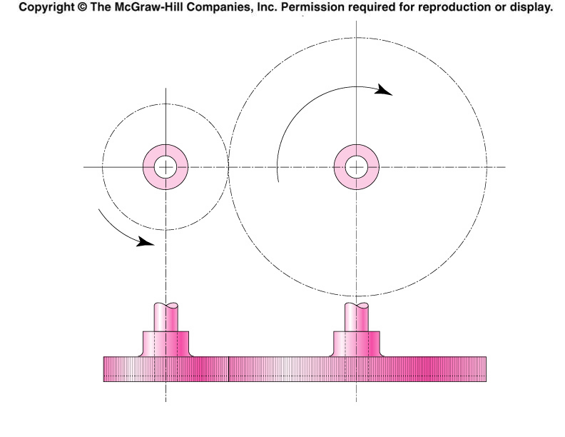
Spur Gears
Are used in transmitting torque between parallel shafts

Slide 13
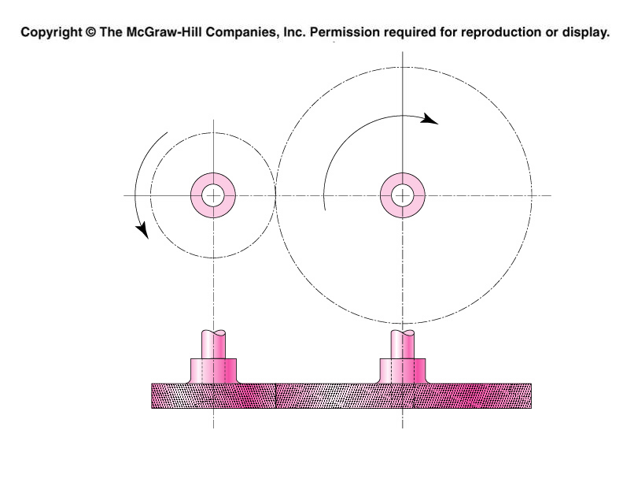
Helical gears
Use:
Helical gears are used for transmitting power between two parallel, non parallel, non-intersecting shafts. Helical gears are used where smooth and quiet running at high speeds is required. Generally, helical gears are used in automobile power transmission.

Slide 14
Spiral gears
Use:
Spiral gears are used to transmit power between two non-parallel, non-intersecting shafts.

Slide 15
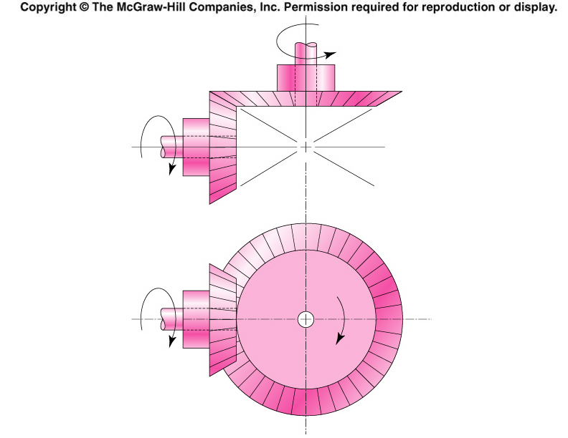
Bevel gears
Use:
Bevel gears are used for transmitting power between two shafts, when the axis of the two shafts are inclined each other. Bevel gears are widely used in automobiles.

Slide 16
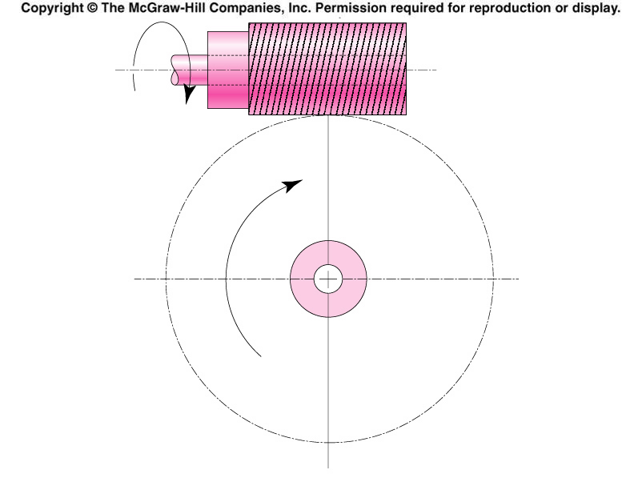
Worm and worm wheel
Use:
Worm gears are used for transmitting power between two shafts having their axis at right angles and non-coplaner

Slide 17
Rack and pinion gears
Use:
the rack and pinion drive is used to convert rotary motion into linear motion. Rack and pinion arrangement, generally used in machine tools, such as lath, drilling, planning machines. It also used in measuring instrument.

Slide 18
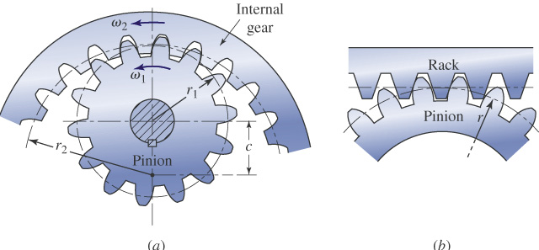
Rack and pinion

Slide 19
Thank You

